Slide 1





Trend Analysis Report
25 - 04 - 2024`
Yash Thale

Slide 2

Overview
Profit and Revenue Growth
How uncertain the growth will be ?

Slide 3

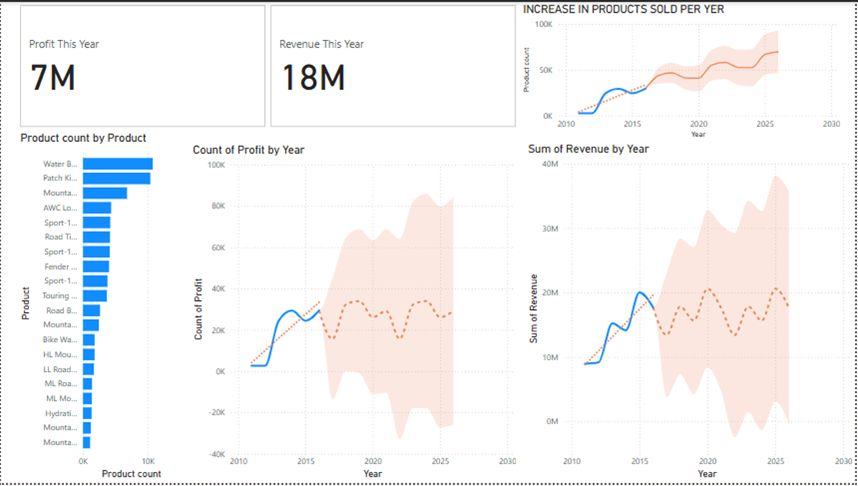
This year KPI’s
Total profit is 7M and Revenue for this year is 18M!

Slide 4

Further details:
The Profit and revenue per year are holding good, Possible uptrend is shown by the trend line!

Slide 5

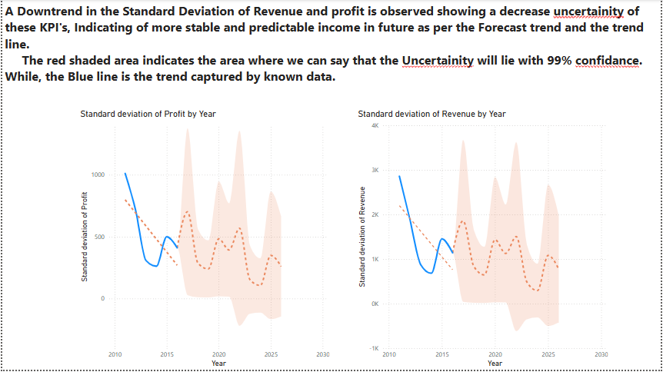
Intrestingly the uncertainity is having a good downtrend, Means more stable profits and Revenue.

